Slide 1
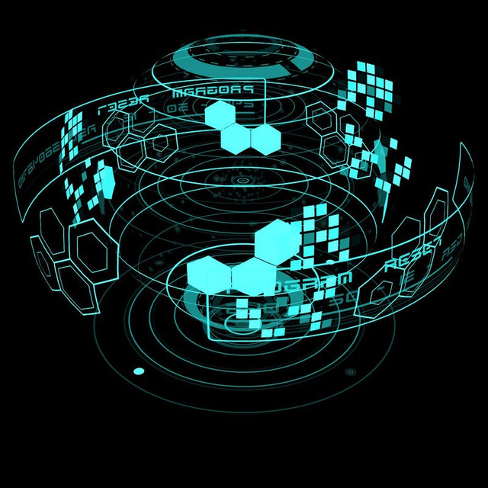
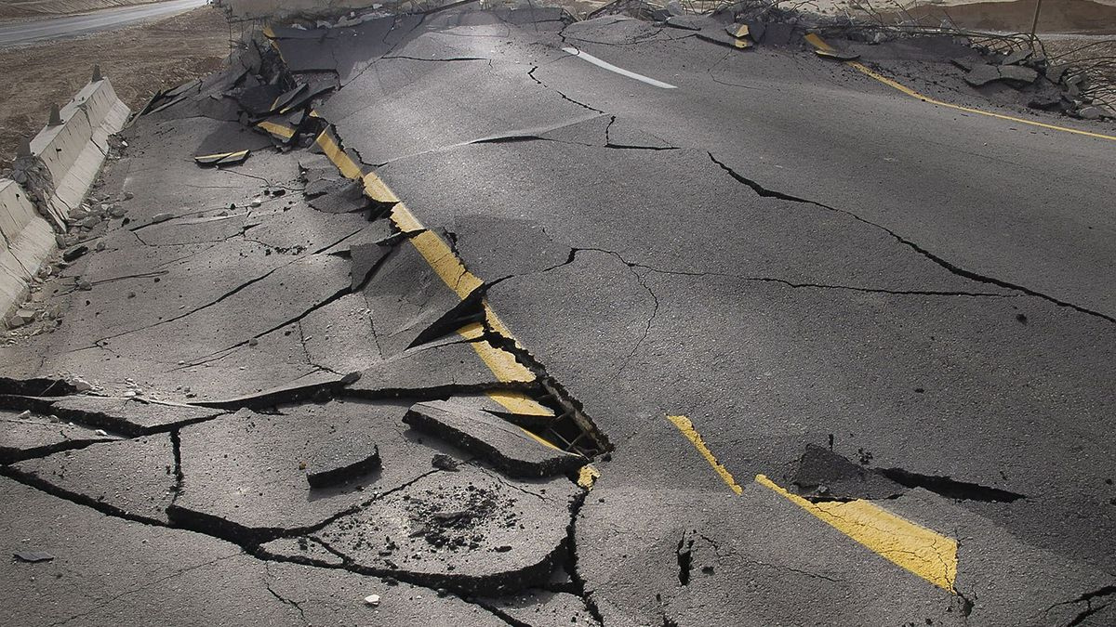
Allpueli: Real-Time AI Emergency Detection System
01
Alp Eren Aydin, Alexander Mateides, Samuel Luis Štúber, Amalia Vinciunaite

Slide 2


Our business proposal
Monitors public transport dashcams to detect emergencies in real-time.
02
Helps emergency services respond faster while protecting passenger privacy.

Slide 3
Who can use it?
03
CITY SERVICES
EMERGENCY SERVICES
DAILY USE

Slide 4




04
How does it work?
!
!

Slide 5
05
SPEED
Allows fast analysis of great volumes of data
Why AI?
EFFICIENCY
Delegates only the important actions to human operators
FUTURE IMPROVEMENT
Can use historical data to update itself continuously

Slide 6

Challenges
Time to analyze the video (5-10 minutes for short segment) made iteration difficult
We didn’t manage to consistently detect vehicle lane for speed estimation
The video didn’t have enough metadata (such as geolocation, kinetics data)
06

Slide 7
07
PRIVACY
Possible identification of faces or other personal data.
Risk of video stream leakage or misuse of access.
Risks & ethics
FAIRNESS
Biased datasets may cause the algorithm to unfairly detect ‘dangerous events’ more frequently or miss some in different circumstances
FALSE POSITIVES
False detection of a ‘dangerous’ situation may lead to unnecessary intervention or deployment of emergency services.

Slide 8
08
PRIVACY
Use of automatic face blurring or other de-identification methods.
Storing data only when an incident is confirmed, rather than continuously
Mitigation
FAIRNESS
Implementing a ‘human-in-the-loop’ procedure: critical decisions are not made fully automatically.
FALSE POSITIVES
Adjusting optimal detection thresholds.
Using a multistage verification process (automatic model first and then a human operator).

Slide 9
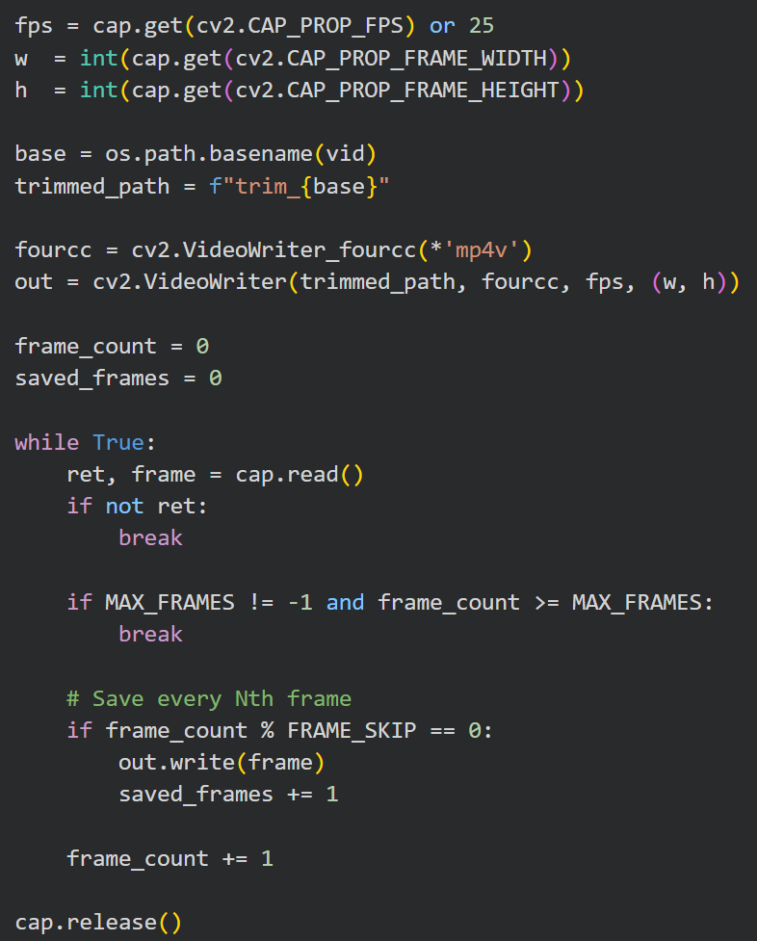
Process & pipeline
Video analysis
uses Python script with multiple models and CV methods to detect the “dangerous” events
Frontend
Based on React TS
Backend
Python FastAPI server
App
Fully dockerized, ready for deployment
09

Slide 10
Next steps & Improvements
Use data from dedicated sensors (geolocation, velocity) instead of using video for estimation
More accurate results
Saves time for analysis
Implement real-time streaming/analysis
Improve GUI and features (report, organizing events)
Add face/car plate blurring to protect privacy
Optionally allow non-public vehicles to join the program
10

Slide 11
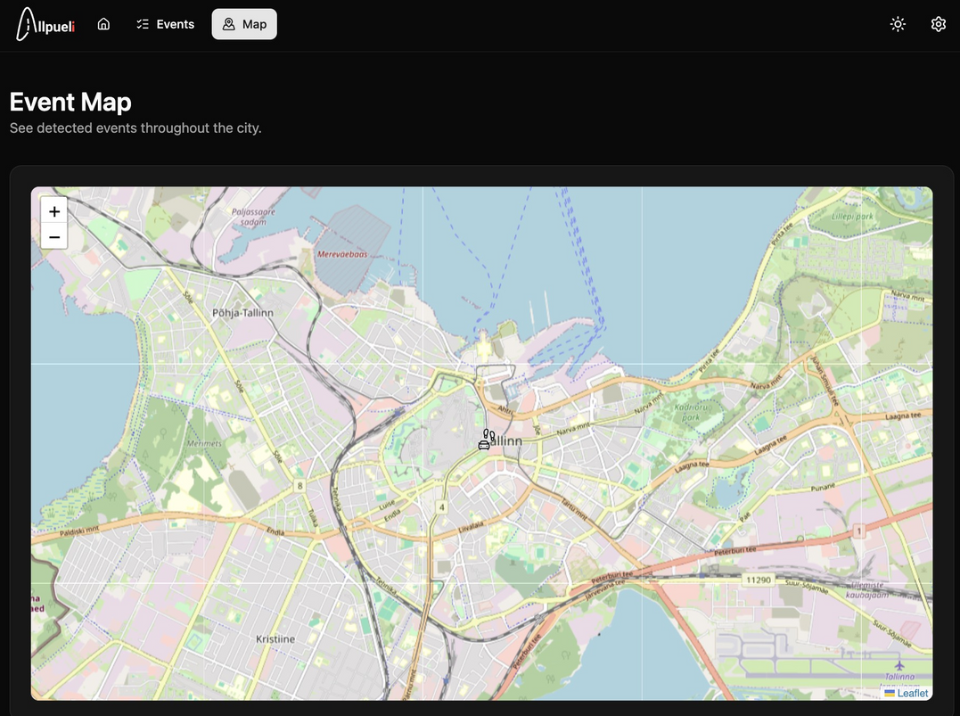
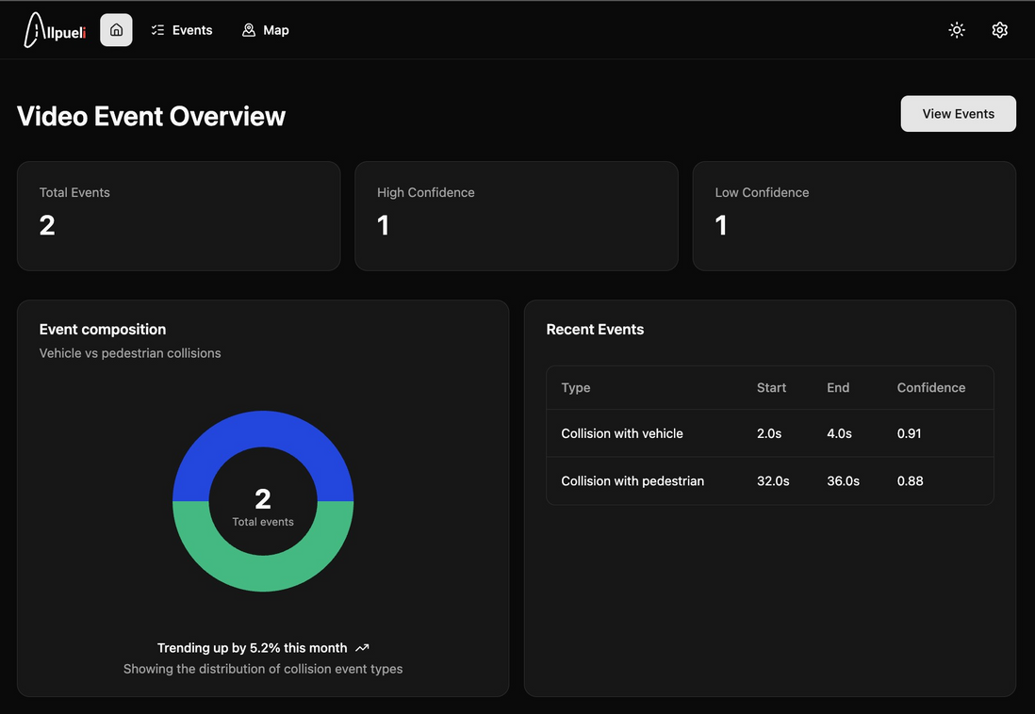
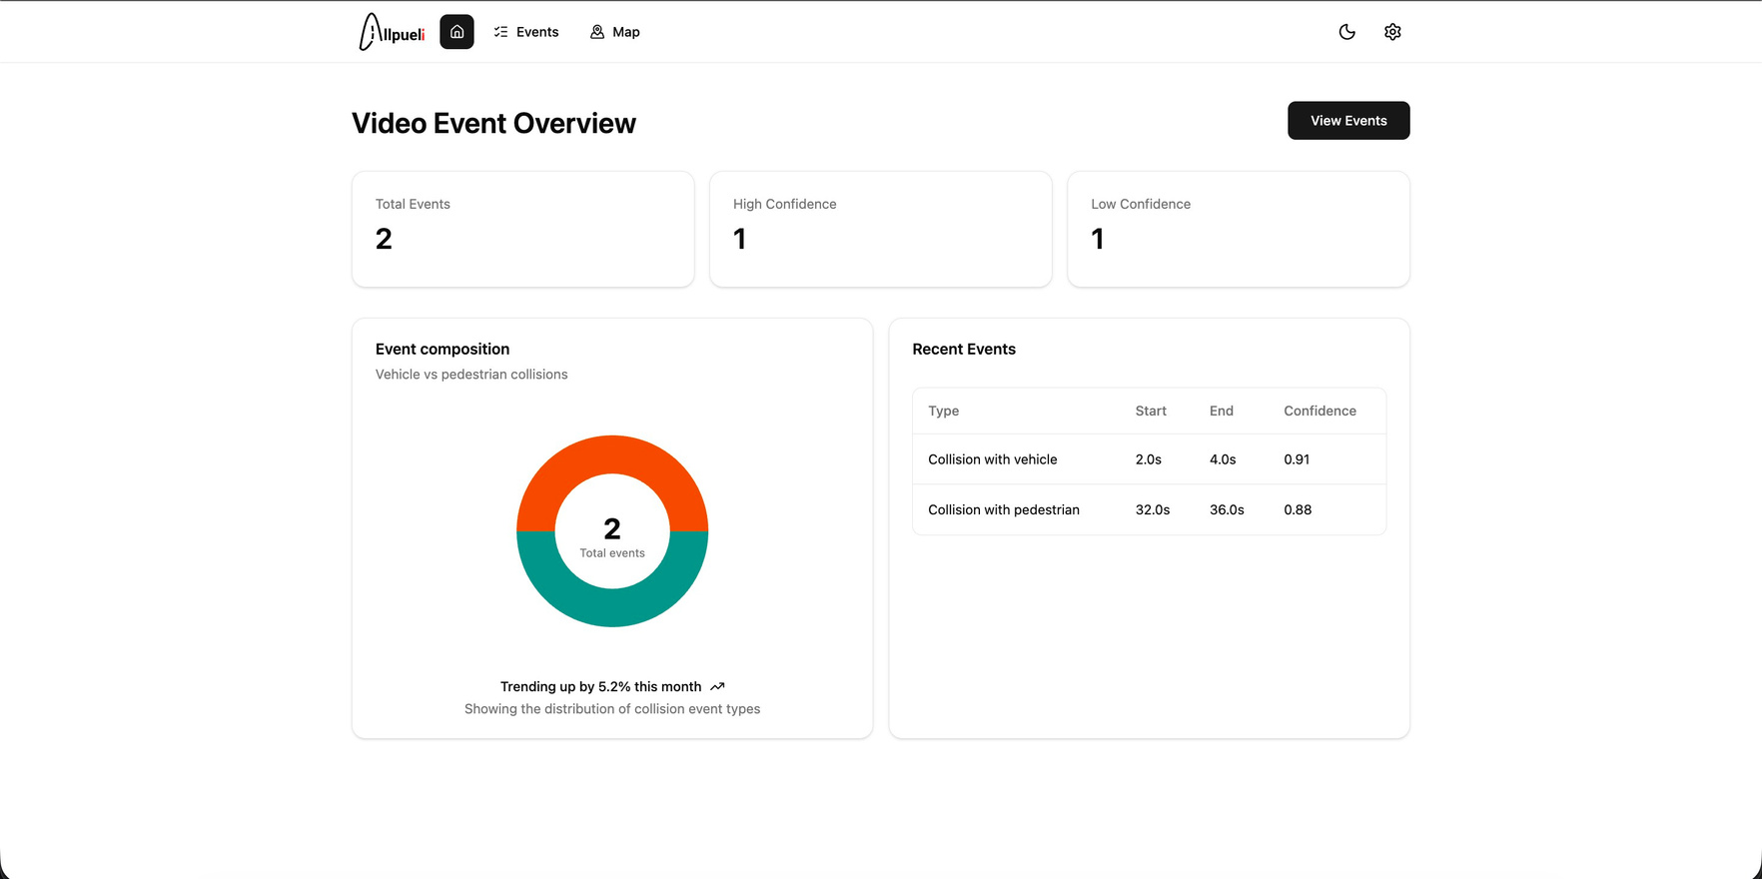
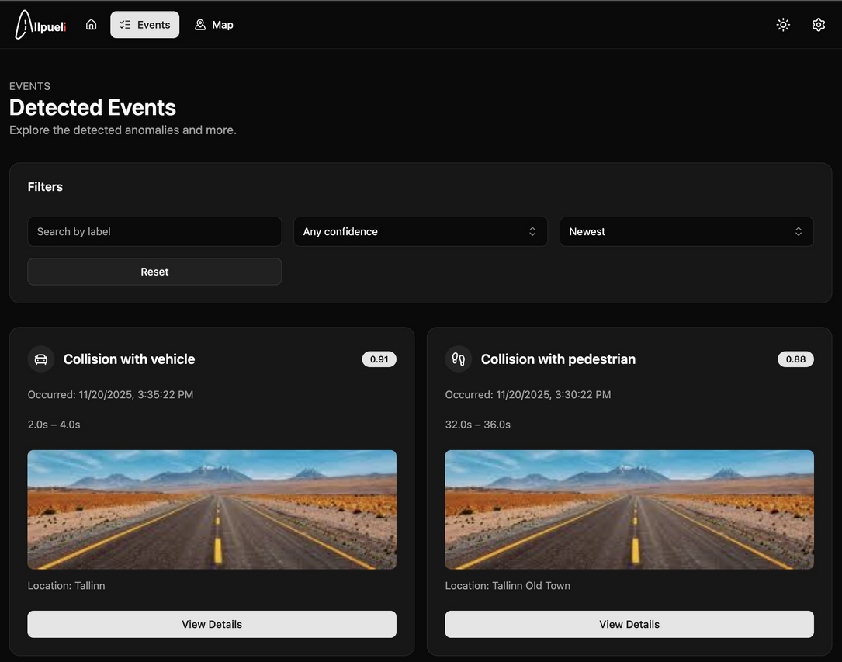
Result
APP
11

Slide 12

12
Thank you for listening!

